Slide 1
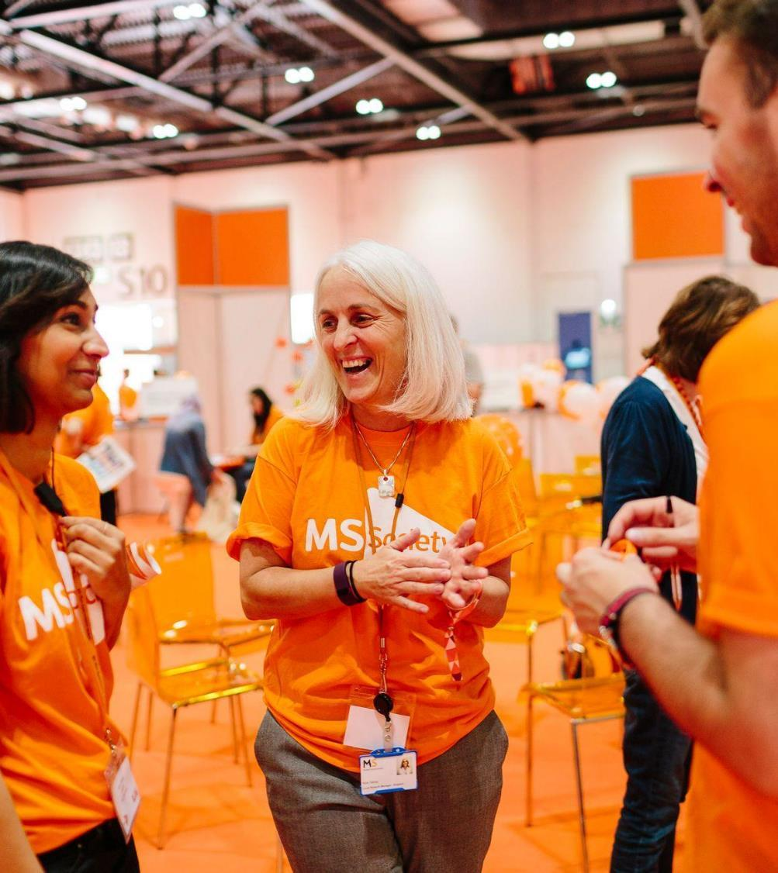
MS Society – who we are and what we do
Together with our MS Community
Healthwatch July 2022

Slide 2
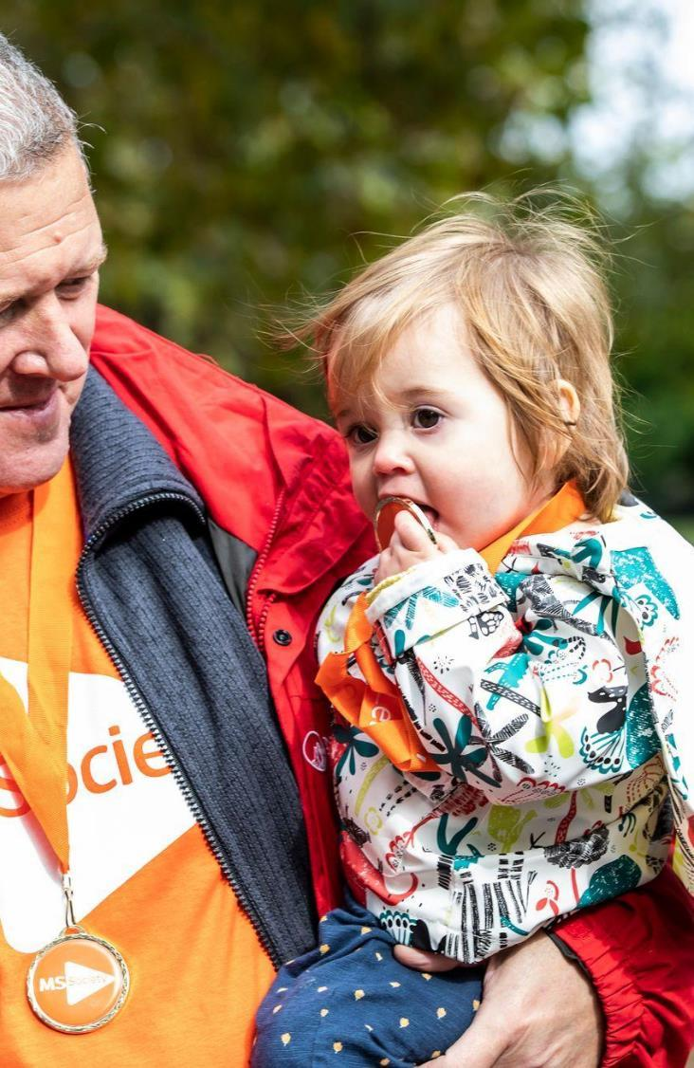
5 things to know
No-one has to face MS alone.
There’s lots of support out there
Everyone’s MS is different
Research is making progress all the time
If you have MS, it may mean making some changes. But you can still have aspirations and achieve goals

Slide 3
Some Stats/Facts
  130,000 people live with MS in the UK
  Estimated number in Northumberland 650*
  Usually diagnosed in your 30s – 50s
  Every one shares the uncertainty of life with MS
  The exact cause is unknown
  It is not infection or contagious
  There is currently no known cure
  Once diagnosed MS stays for life
  * source ONS Mid-2022 Population Estimates for Clinical Commissioning Groups in England

Slide 4

Possible causes

Slide 5
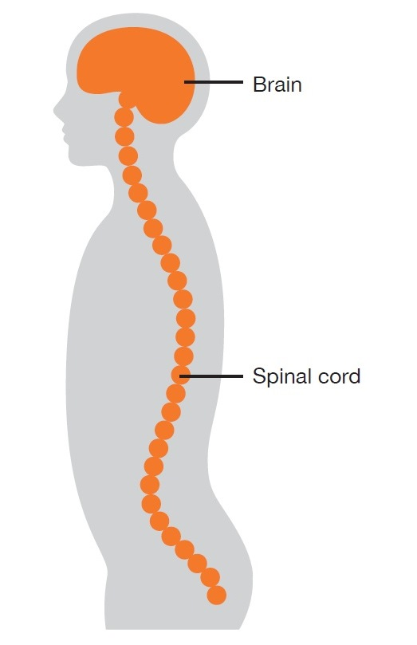
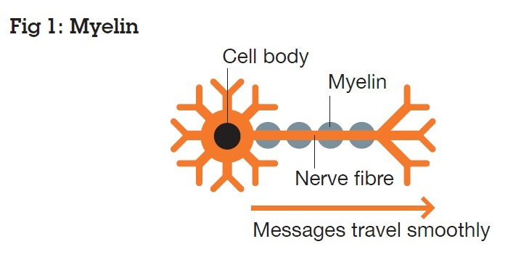
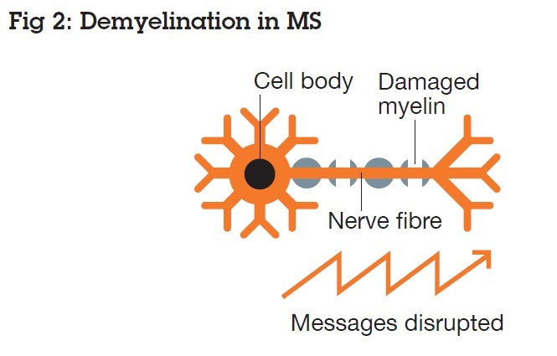
What happens in MS

Slide 6
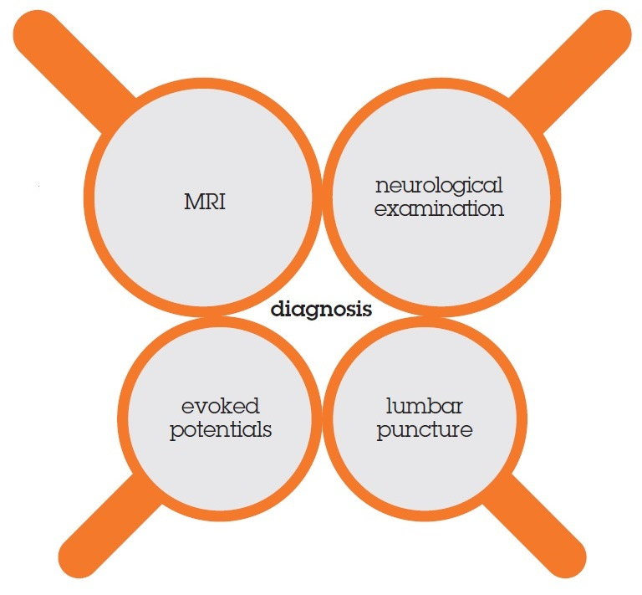
Diagnosis

Slide 7
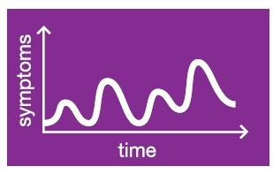
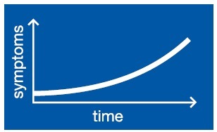
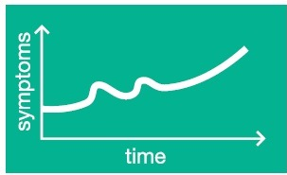
Is everyone’s MS the same?
Relapsing remitting
Primary Progressive MS
Secondary Progressive MS

Slide 8
Common Symptoms
  Fatigue
  Sensory problems
  Visual problems
  Sexual problems
  Bladder and bowel problems
  Muscle stiffness and spasms
  Problems with walking, balance and coordination
  Speech and swallowing difficulties
  Cognitive problems
  Pain

Slide 9
Invisible symptoms
  “You look so well”
  Difficult for others to understand
  Frustrating for the person to describe
  May lead to further difficulties (at work, socially, etc)

Slide 10
Impact on daily life
Physical
  Fluctuating and unpredictable
Emotional
  Anxiety, stress, altered mood
Social
  Difficult or too tired to go out / do activities
Economic
  Work issues / benefits

Slide 11
Can MS be treated?
Relapsing remitting MS
  - disease modifying drugs
  - relapse treatments
Progressive MS
  - no treatment to alter progression
  - more research needed

Slide 12
Managing MS Symptoms
  There are treatment options for most of the symptoms experienced.
  Most symptoms managed/ treated by prescribed (conventional) medicines
  Diet and exercise
  Self-management techniques and/ or complementary and alternative therapies can also be beneficial
  Specialist support and rehabilitation

Slide 13
Who helps manage your MS symptoms?
  Following diagnosis people will be supported by several specialists:
  The main point of contacts will be your neurologist for your annual review (and the nurse team at the RVI)
  Your MS Specialist Nurse Team based at 10 Bailiffgate; Alnwick, NE66 1LX; 01665 511971 Msnurse.NLD@northumbria-healthcare.nhs.uk
  Your GP
  But there are also others such as
  Occupational therapists, neuro-Physiotherapist, Orthotist, Psychologist, Continence Nurse

Slide 14
MS Society
MS Society founded in 1953 - operates across UK and provides:
Helpline Information and support
Research Largest UK charitable funder of MS research
Campaign for a better deal; benefits changes & access to treatments
Local Community Teams help people connect in their local area

Slide 15
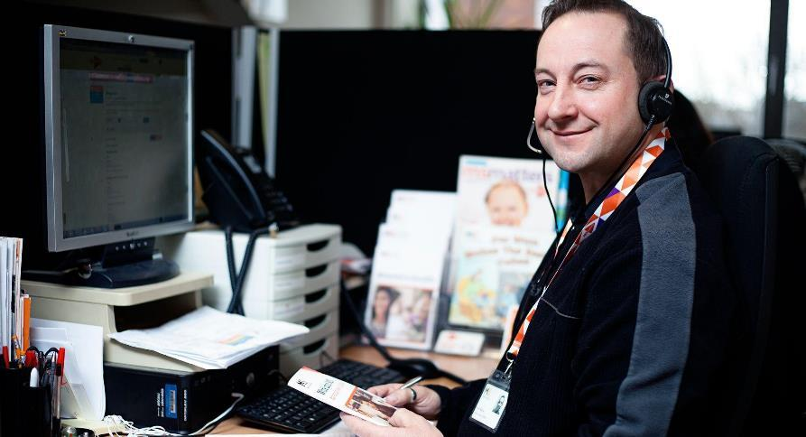
MS Helpline – Freephone 0808 800 8000
Our MS Helpline gives emotional support and information to anyone living with MS.
Direct private messages can be sent on Facebook messenger and a confidential email service: helpline@mssociety.org.uk
Also have specialists available:
MS Nurses
Helpline Benefits Advisor
Disability Law Service - free, confidential advice to people affected by MS in England and Wales.
Moving More with MS

Slide 16
Some other services/activities
  On Line MS Fatigue Management Course - 6 accessible 20 minute sessions
  Online community/Forum
  Interactive Information Webinars - themed regular webinars
  Information events and free print and downloadable publications on a variety of topics

Slide 17
Local services and activities
  Local groups cover a specific geographical area
  Self funded and volunteer-led
  Provide:
  local information/signposting
  emotional support (eg counselling/telephone contact line)
  access to physical activity
  Social and peer support opportunities

Slide 18
Local Group Contacts.
Alnwick and district 07581 460 207
Alnwick@mssociety.org.uk
South Northumberland 07749 384 598
southnorthumberland@mssociety.org.uk

Slide 19
National contacts.
MS Helpline - 0808 800 8000
MS Website – www.mssociety.org.uk
Regional Development - Sheila.greenwood@mssociety.org.uk

Slide 20
What it means to me – a personal perspective
Glynis

Slide 21

Any Questions?
Thank you for listening

