Slide 1
Autism
Nellie Allsop, National Autistic Society

Slide 2
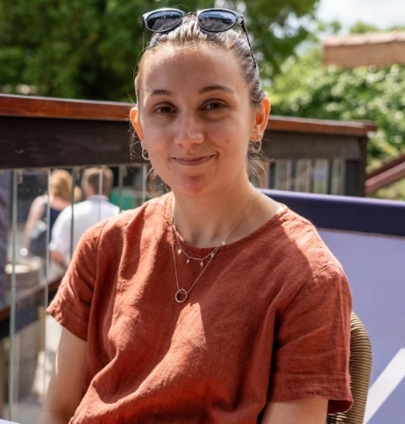
About me
Senior Branch Engagement Officer (North of England)
I support volunteer-led branches of the charity across the North of England, including:
North Northumberland branch
Hexham branch
Tyne and Wear branch
Diagnosed as autistic in September 2020 following a mental health crisis. Brother (and most likely Father!) are also autistic.

Slide 3
What is autism?
Autism is a developmental disability which affects the way a person understands the world around them. Autism is…
lifelong
a spectrum condition
different for everyone.
Autistic people are individuals with their own likes and dislikes, talents and challenges, dreams and ambitions.
Notes:
SLIDE 10 – What is autism?
Autism is a developmental difference in the brain. It affects the way a person interacts with and understands the world around them. We still don’t know exactly what causes some people to be autistic and not others. There is no ‘cure’ for autism, and the idea of a cure is often deeply upsetting to people on the autism spectrum and their families who see it as a big part of themselves or their loved one.
Autism is lifelong, so autistic children will become autistic adults. Many autistic adults develop strategies which help them interact with others and lead an independent life. Others might have very complex support needs and require a lifetime of specialist support.

Slide 4
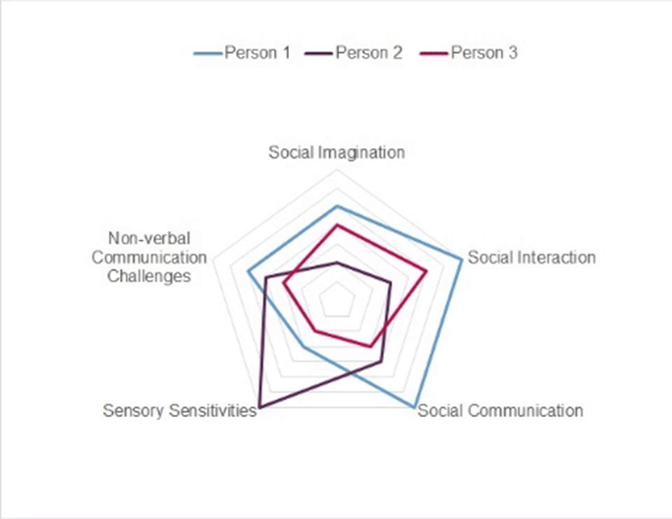

What’s a spectrum condition?
Some autistic people need lots of support as they have complex needs. Others need very little support and might live independently.
All autistic people share certain difficulties in areas such as social communication, imagination and interaction.
Notes:
SLIDE 11 – What’s a spectrum condition?
The most important thing for people to know is that everyone on the autism spectrum is different. Whilst autistic people share some common difficulties, any one person’s experience of autism is entirely their own. Some people have sensory difficulties whilst others might not. About 4 in 10 people on the autism spectrum also have a learning disability which may bring its own challenges, or compound the challenges brought by that person’s autism.
It’s really important to treat people as individuals. As the saying goes – ‘if you’ve met one person with autism, you’ve met one person with autism’.

Slide 5
Extra processing time
Some autistic people might need some extra time to process information.
Lots of spoken information all at once can be a bit of a jumble. It might take a few seconds for an autistic person to make sense of it.
An autistic person might need a little extra support to fill in forms or digest lots of written information. Writing things down for autistic people can be helpful to them.
Notes:
SLIDE 12 – Extra processing time
We all use processing powers all the time. It’s what allows us to focus on a conversation in a crowded room, or comprehend the double meaning of a joke. Some autistic people need a little extra time to process the information that’s presented to them so that they fully understand the message. There’s no hard and fast rule for how long a person might need to process information, but you shouldn’t be afraid to leave a short period of silence after a question to allow an autistic person a little extra time to understand.

Slide 6
Anxiety in social situations
Some autistic people might find social situations challenging. These might include…
Using public transport
Meeting new people
Going to the shops
Visiting a new or busy place, like the theatre
Notes:
SLIDE 15 – Anxiety in social situations
A social situation is a situation in which you may need to interact with another person. These can be quite challenging for an autistic person and might cause a level of anxiety. This could stem from having had a bad experience with a bus driver, or an intimidating encounter with a shop security guard, or perhaps a new person made a crass or hurtful comment about autism. All of these small worries can build up over time to become completely unbearable.

Slide 7
Anxiety from unexpected changes or events
You may have heard that autistic people tend to like routines. This is true for some – organising your day and knowing what’s planned can be very calming.
Sometimes plans go wrong or changes need to be made at late notice. Trains get delayed, buses get cancelled, meetings get moved and friends cancel plans.
These unexpected changes can cause an autistic person to feel anxious.
Notes:
SLIDE 17 – Anxiety from unexpected changes or events
Autistic people often like to have routines. Knowing what the day has in store can help to reduce some of the anxiety that otherwise might build up.
Sometimes plans change at very late notice, and this can be very upsetting for an autistic person. If one thing goes wrong, it might have a domino effect and throw all of the day’s plans out of the window.

Slide 8
Can you make it to the end?
Link to video: https://www.youtube.com/watch?v=aPknwW8mPAM

Slide 9
Meltdown or Shutdown
When it all becomes too much and an autistic person is unable to cope any more, they might have a meltdown.
Just as all autistic people are different, meltdowns can be very different too. Some people might be very quiet, others may cry or seem upset.
It’s important to recognise that autistic meltdowns are not a form of misbehaviour, they are the response to a challenging environment or circumstance.
Notes:
SLIDE 25 – Meltdown
Sometimes, everything we’ve discussed already can build up and become too much to bear. In some cases, an autistic person might have a meltdown and might be unable to cope with the situation any further. As we’ve discussed, all autistic people are different, so autistic meltdowns can be very individual as well. Some people might be unable to speak and might close their eyes or put hands over their ears, others might cry or seem upset.
The most important thing to recognise with meltdowns is that they are not voluntary acts of misbehaviour. They are a last ditch response to a very challenging environment or circumstance.

Slide 10
Social Isolation
Our recent survey showed us that 79% of autistic people feel socially isolated and that 28% of families with an autistic member have been asked to leave a public place.
This is mostly because of judgemental attitudes from the general public.
But autistic people have every right to socialise, go shopping, visit the cinema or theatre, use the leisure centre. A public place should be just that – public.
Notes:
SLIDE 27 – Social Isolation
We’ve talked about a lot in our session today:
The main features of autism
Some common misconceptions of the condition
Some specific difficulties an autistic person might experience in everyday life
All of these difficulties can make going to the shops, visiting the cinema or going out to lunch very challenging. And misconceptions from the general public can add to the challenge. In a recent survey, we found out some shocking statistics about the levels of isolation that autistic people face.
79% of autistic people feel socially isolated and
28% of families with an autistic member have been asked to leave a public place because of behaviours associated with autism
But public places should be accessible to all – only then will they be truly PUBLIC.

Slide 11
Support and more
Local | National
North Northumberland branch: www.autism.org.uk/what-we-do/branches/north-northumberland ASD and Girls group (online) Forest school sessions Craft group Support group (for adults and parent/carers) | NAS specialist helplines (www.autism.org.uk/what-we-do/help-and-support) Education rights Transition support Educational tribunal support School exclusion Autism inpatient mental health Parent to parent
Other local branches (Hexham, Tyne and Wear) | NAS website: www.autism.org.uk
Sensory garden (Howick Hall Gardens) | Online community: www.autism.org.uk/what-we-do/community

Slide 12
Questions
nellie.allsop@nas.org.uk

